Slide 1
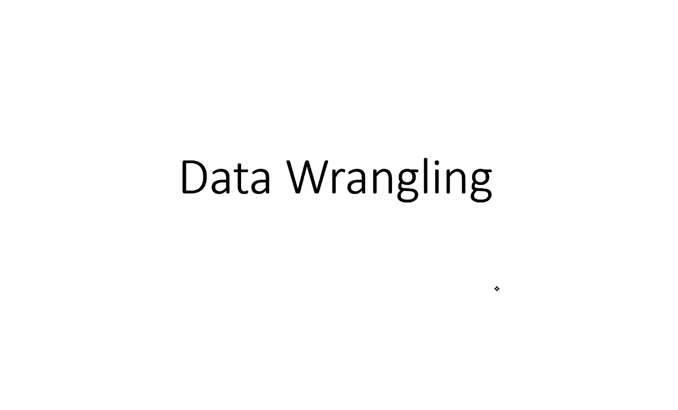
Institute of Science and information Technology
By – Indresh Soni

Slide 2
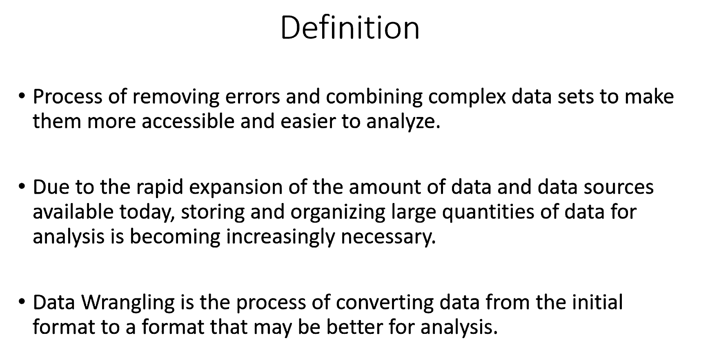
Institute of Science and information Technology

Slide 3
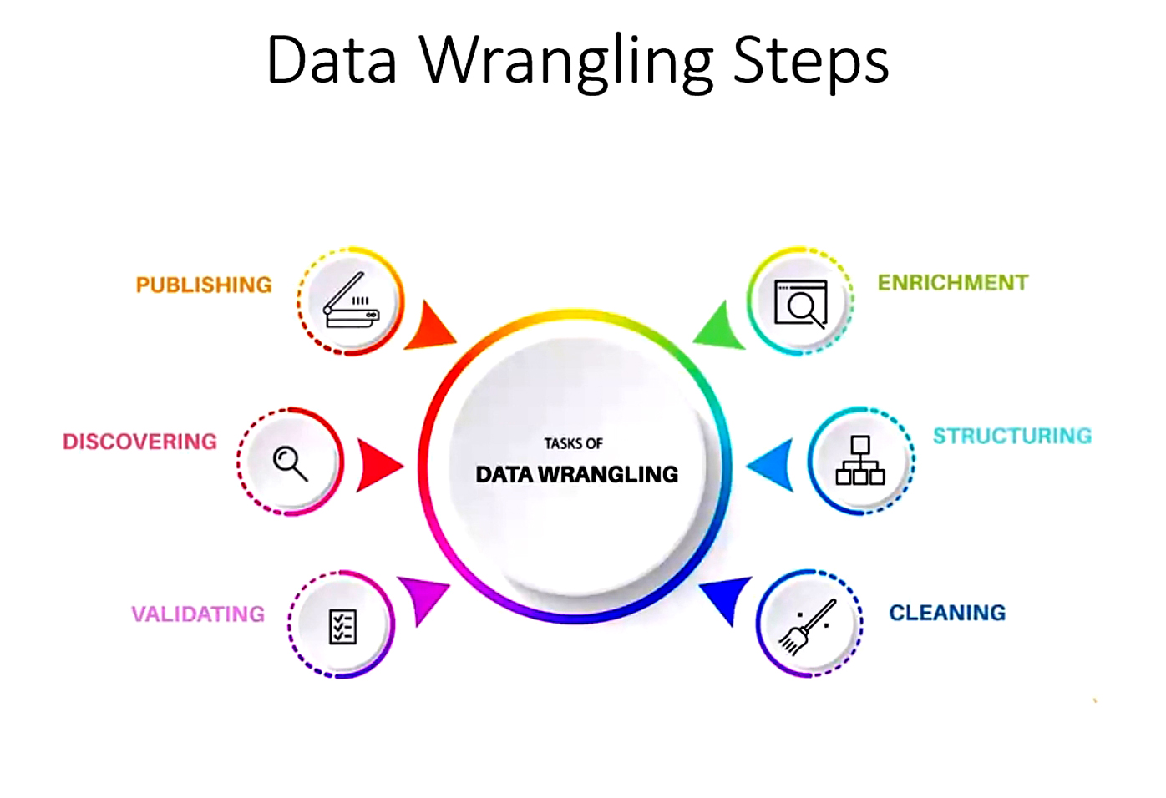
Institute of Science and information Technology

Slide 4
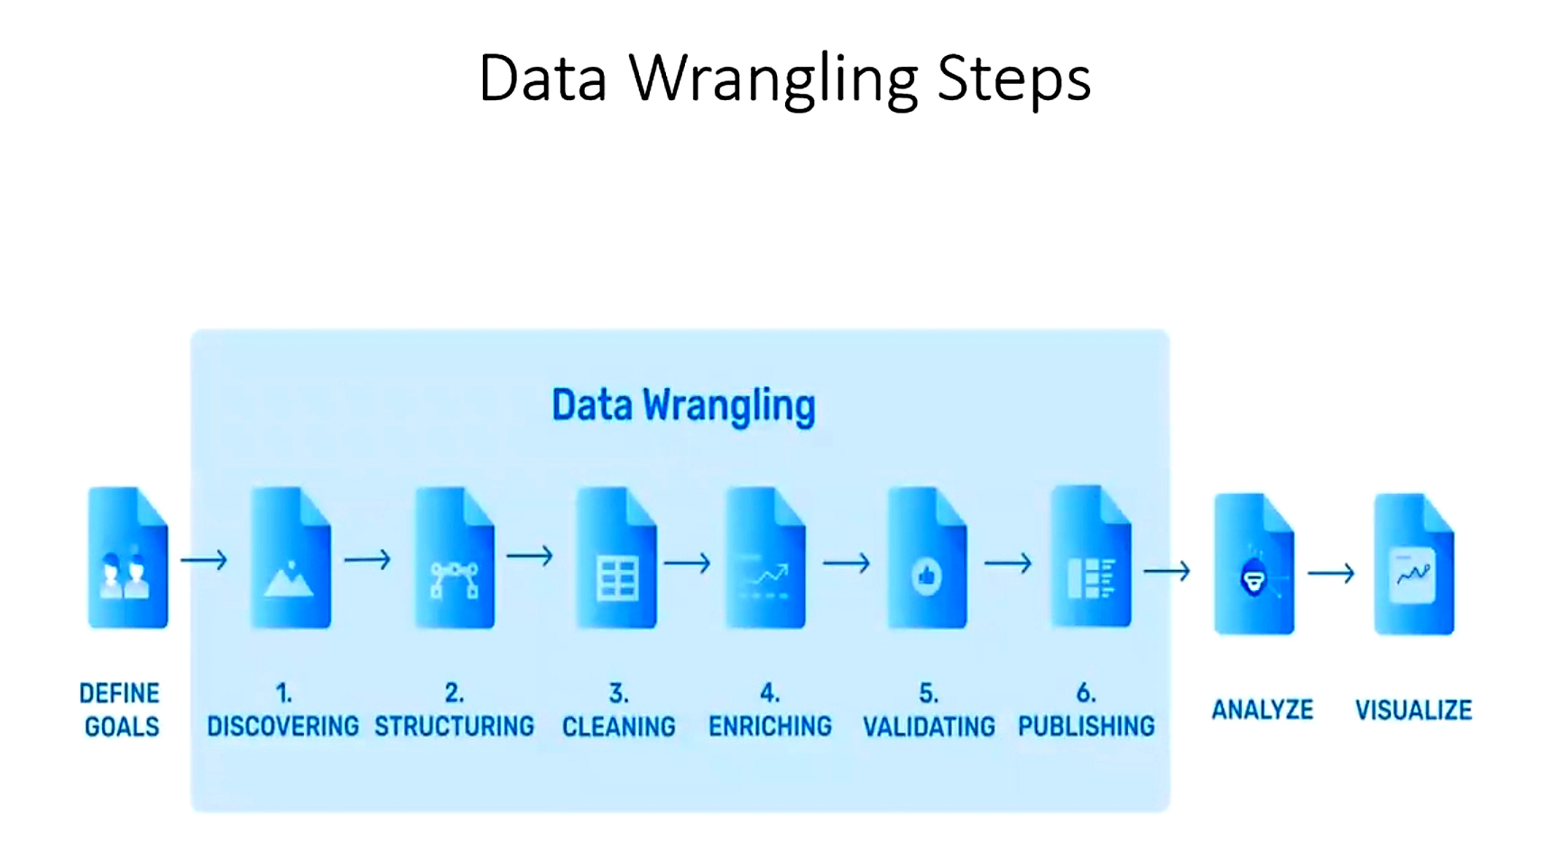
Institute of Science and information Technology

Slide 5
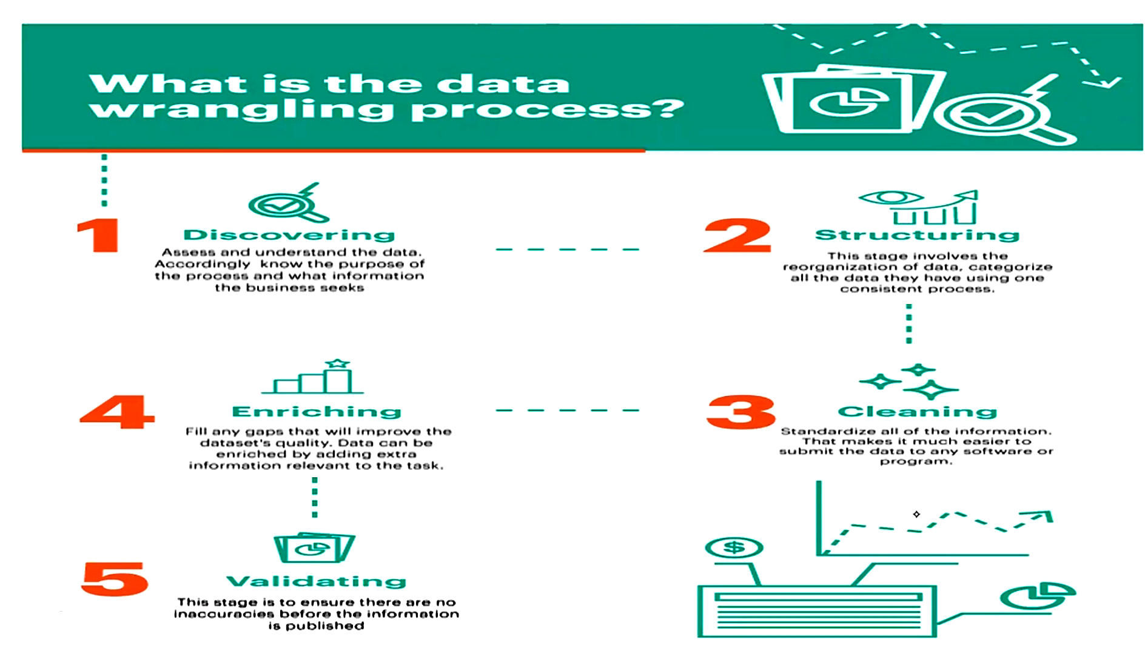
Institute of Science and information Technology

Slide 6
Institute of Science and information Technology
Data Types
Data Analytics
Python /Other Language
Int, float, Str, bool, complex, None
Quantitative
Qualitative
Numerical Data Like Int and float
Categorical Data Like Str and Bool
Continuous Variable
Nominal
Range value like height, weight, length
No Internal Hierarchy
ex- Blood Groups
Discrete Variable
Range steps are fixed like count population
Ordinal
Interval Variable
Education Qualification order
Ex – 10th pass is less educated to 12th
Fixed range difference like temp
Ratio Variable
Interval difference is fixed
Like 120 -130 =10 and 110-120=10

Slide 7
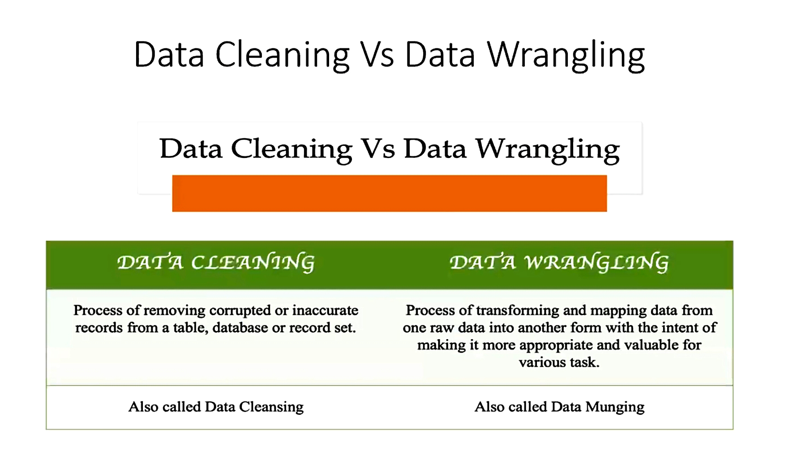
Institute of Science and information Technology

Slide 8
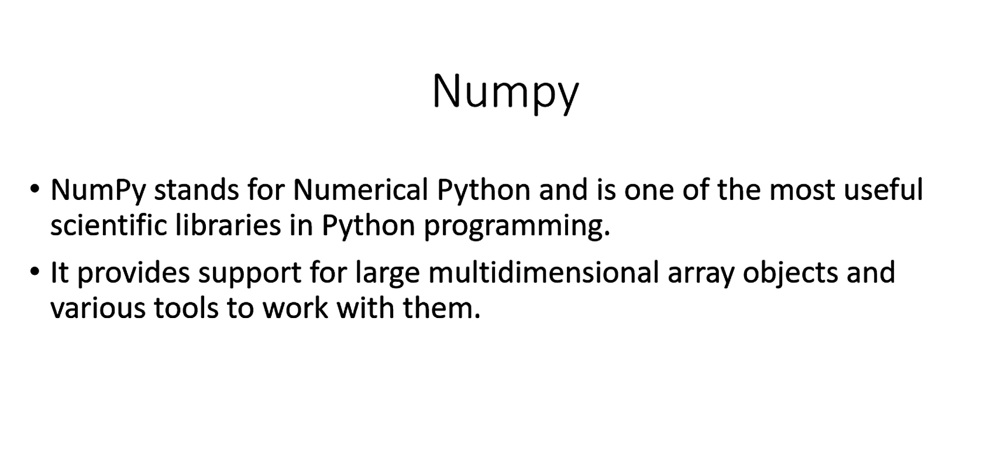
Institute of Science and information Technology

Slide 9
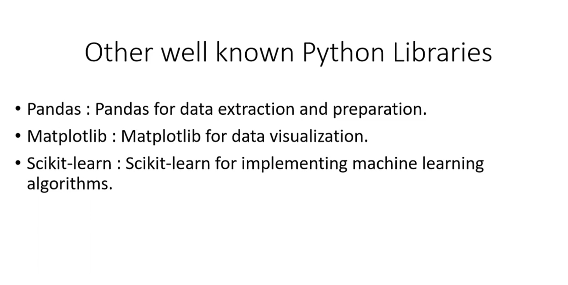
Institute of Science and information Technology

Slide 10
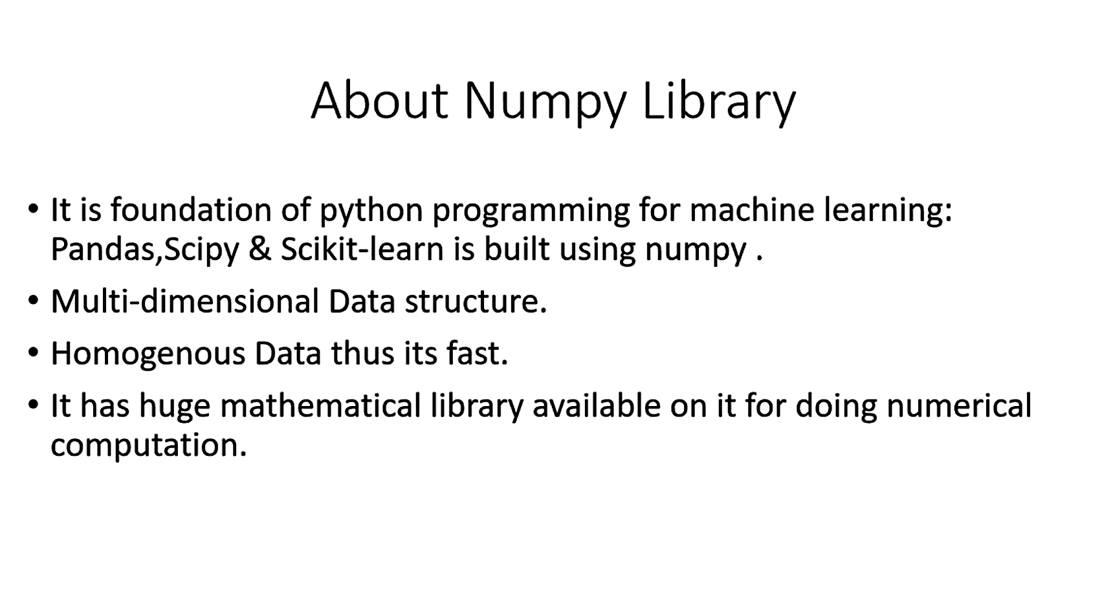
Institute of Science and information Technology

Slide 11
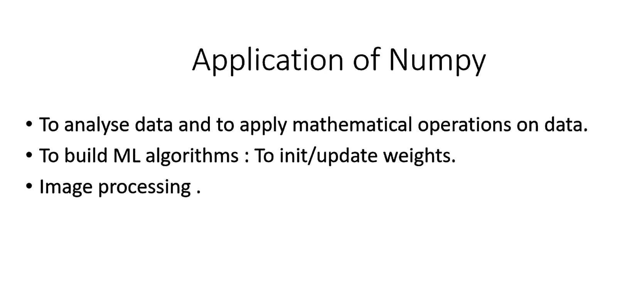
Institute of Science and information Technology

Slide 12
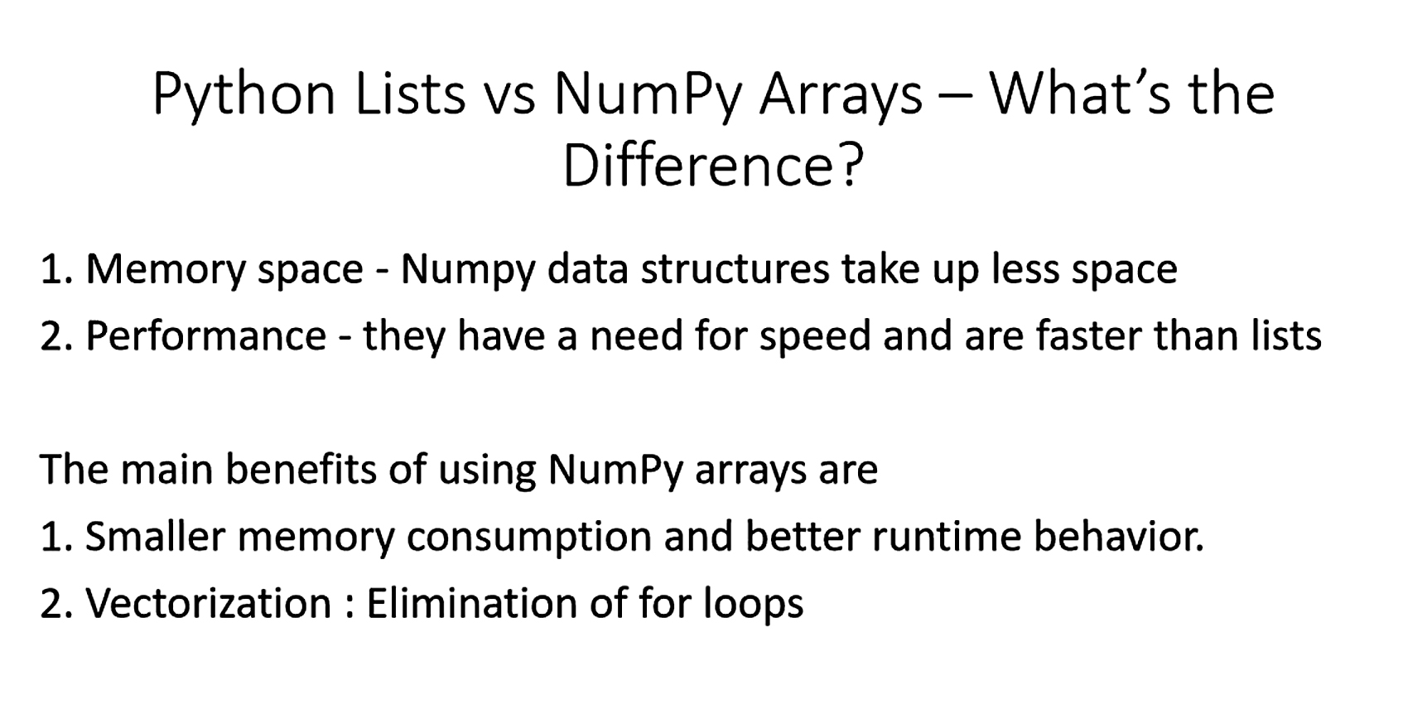
Institute of Science and information Technology

